Slide 1


Slide 2

Topics
What is Auto Scaling
Scaling Options

Slide 3
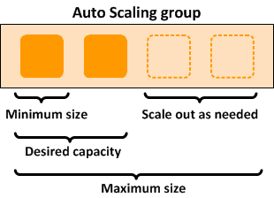
What is Auto Scaling?
Amazon EC2 Auto Scaling helps you ensure that you have the correct number of Amazon EC2 instances available to handle the load for your application
Groups
Logical components. Web server group or your application group or your database group is just a logical component where you're going to put your EC2 instances in.

Slide 4
What is Auto Scaling?
Configuration templates
Group uses a launch template or a launch configuration as a configuration template for it's EC2 instances.
it's the instructions which EC2 instances to launch, what size and storage
You can specify information such as the AMI ID, instance type, key pair, security groups and the block device mappings for your instances.

Slide 5
Auto Scaling
Scaling Options
Scaling options provides several ways for you to scale your Auto scaling groups.
For example, you can configure a group to scale based on the occurrence of a specified condition (dynamic scaling) or on a schedule.
What are your scaling options.
Maintain the current instance levels at all times.
Scale manually
Scale based on a schedule
Scale based on demand
Use predictive scaling

Slide 6
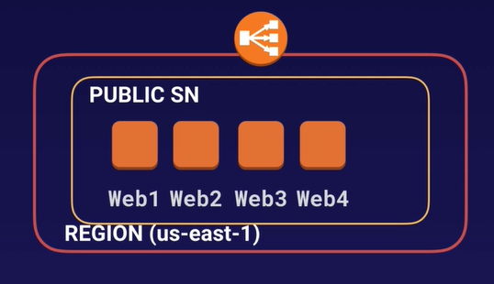
Scaling Option
Maintain your current instance levels at all times.
You can configure your auto scaling groups to maintain a specified number of always running instances.
To maintain the current instance levels, Amazon EC2 auto scaling performs a periodic health check on running instances within an auto scaling group.
When Amazon EC2 auto scaling finds an unhealthy instance, it terminate that instance and then launch a new one.

Slide 7
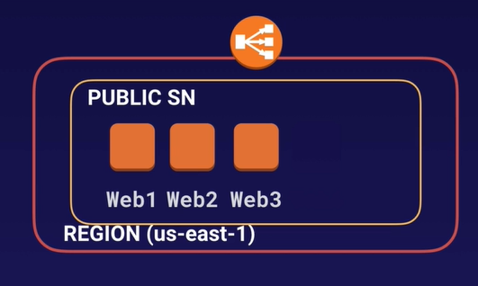
Scaling Option
Scale manually
Manual scaling is the most basic way to scale your resources, where you specify only the change in the maximum minimum or desired capacity of your auto scaling group.
Amazon EC2 auto scaling manages the process of creating or terminating instances to maintain the updated capacity

Slide 8
Scaling Option
Scale based on a schedule
Scaling by schedule means that the scaling actions are performed automatically as a function of date.
This is useful when you know exactly when to increase or decrease the number of instances in your group simply because the need arises on a predictable schedule.
Use predictive scaling.
You can use Amazon EC2 auto scaling in combination with AWS auto scaling to scale resources across multiple services
AWS auto scaling can also help you maintain optimal availability and performance by combining predictive scaling and dynamic scaling (proactive and reactive approaches) to scale your Amazon EC2 instances capacities faster.

Slide 9
Scaling Option
Scaling on demand
A more advanced way to scale your resources - using scaling policies - let you define the parameters that control the scaling process.
For example, let's say you have a web application that currently runs on two instances and you want the CPU utilization of the auto scaling group to stay at around 50 per cent when the load on the application changes.
This method is useful for scaling in response to changing conditions, when you don't know when those conditions will change.
You can set up Amazon EC2 auto scaling to respond for you.

Slide 10
Thank you

